Slide 1
The Invention Process: Step 1
Think it
Identify a Problem or Need
Notes:
Step One: Think It

Slide 2
Step 1: Think It
1
2
3
4
5
6
7
Notes:
In this lesson, you are going to learn how to complete the first step in the invention process, THINK IT. You’ll identify a problem that you would like to solve and begin to imagine your solution!

Slide 3
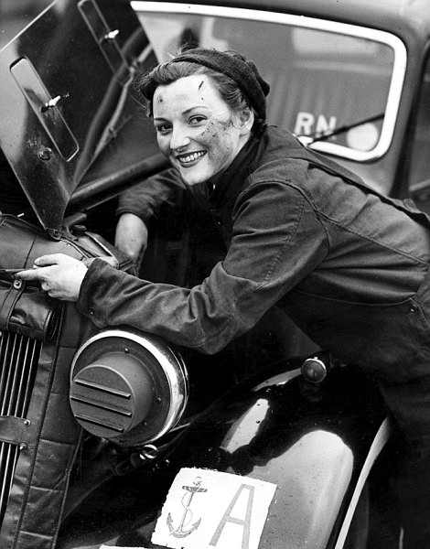
Inventors Solve Problems
Improve Inventions
Find new ways to make things work better.
Design machines that work more efficiently.
Eldorado Jones
Notes:
Eldorado Jones invented an airplane muffler and many other useful inventions.

Slide 4
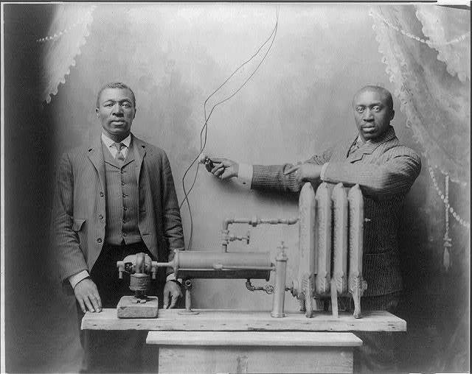
Inventors Solve Problems
Inventors see a need and don’t give up until they find a solution that works.
Charles S.L. Baker
Notes:
Charles Baker and his assistant demonstrate the radiator invention.

Slide 5
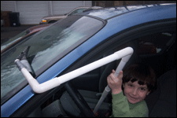
Turbo Skraper
Sam – Pennsylvania, USA
Inventions Solve Problems
Notes:
In past Invent It Challenges, students like you have solved many different kinds of problems. For example, seven-year old Sam tackled the issue of people getting cold while scraping ice and snow from their car windshield. How? By creating a scraper that can be used from inside the car!

Slide 6
Inventions Solve Problems
Chase – North Carolina, USA
Refugee Travois: Salvation on Wheels
Notes:
Chase, a 13-year old from North Carolina, invented a refugee travois to help a single parent easily transport multiple children easily to safety.

Slide 7
Personal
School
Community
Global
Identify a Problem
Notes:
To identify a problem you might want to solve as an inventor, start by brainstorming. Grab your pencil or computer and make a list of problems.

Slide 8
Personal
School
Community
Global
Can’t find things in a purse
Marlie S.
- Mississippi, USA
Desks too short for tall
students
Laila E., Angela A., Mitzi C. - California, USA
Unorganized sports
equipment
Pierre S., Léa S., Clément S., Laurie V., Sarah G., Adrien B., Romain J., Justin M., Théo L., Mathis D., Mathilde S. - France
Trash around community
Emily B., Abby T. - Florida, USA
Driving wrong way on highway exit causing accidents
Charlotte J. - California, USA
Identify a Problem
Notes:
First, think about your own life. What current products frustrate you? What problems do you have in your home, school, or community that an invention might help? Next, ask friends, family, and teachers what problems they’d like to solve. As you listen to their responses, think about how solving their problems could help others improve their lives.

Slide 9
Personal
School
Community
Global
Can’t find things in a purse
Marlie S.
- Mississippi, USA
Children eating unhealthy foods
Nithin S. - India
Desks too short for tall
students
Laila E., Angela A., Mitzi C. - California, USA
Cars using too much gasoline
Damian J.
- New Jersey, USA
Unorganized sports
equipment
Pierre S., Léa S., Clément S., Laurie V., Sarah G., Adrien B., Romain J., Justin M., Théo L., Mathis D., Mathilde S. - France
Trash around community
Emily B., Abby T. - Florida, USA
Driving wrong way on highway exit causing accidents
Charlotte J. - California, USA
Medicines not available in remote villages
Trisha
- India
Identify a Problem
Notes:
Finally, read the newspaper or watch the news to find out about bigger, global problems you could tackle.

Slide 10
Personal
School
Community
Global
Problem
Problem
Problem
Problem
Problem
Problem
Problem
Problem
Choose a Problem to Solve
Notes:
Once you have a list, you’ll have a big decision to make! Which problem fascinates you? Which problem is possible for you to solve with a new invention?

Slide 11
Personal
School
Community
Global
Problem
Problem
Problem
Problem
Problem
Problem
Problem
Problem
Choose a Problem to Solve
Notes:
Using the process of elimination, cross off the ideas that least interest you, or that you don’t think you could solve with a new invention.

Slide 12
Personal
School
Community
Global
Problem
Problem
Problem
Problem
Problem
Problem
Problem
Problem
Choose a Problem to Solve
Notes:
Make your final decision by selecting the problem that really sparks your curiosity and gets you excited about inventing! Remember, identifying your problem and solution is the bedrock of your invention! Choose wisely!

Slide 13
Most people don’t get enough sleep.
Sports can be dangerous
for players.
It’s difficult to make smart food choices.
We spend too much time staring at screens.
Get Started
Notes:
Get started on this challenge right now by listing possible natural disaster preparation or relief problems on the first page in your Inventor’s Notebook. You may wish to start a section titled Think It!

Slide 14
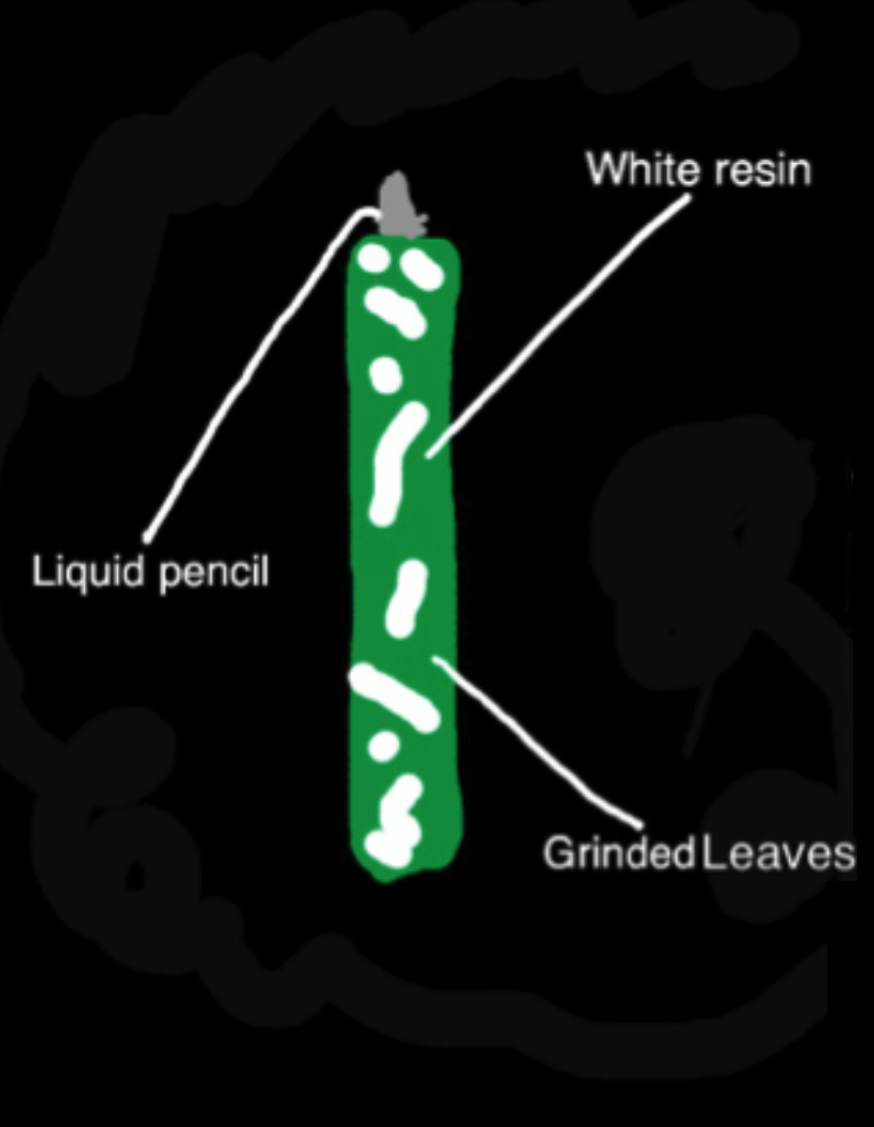
Pencils are made of wood
Save trees with improved pencil
Get Started
Notes:
Then use your notebook to capture all your notes and sketches throughout the steps of your invention process. Your notebook will help you when you prepare your entry for submission.

Slide 15
That’s the 1st Step in the invention process.
Can’t wait to see your problem
Notes:
Now you know how to complete Step 1 of the invention process, THINK IT!, by generating a list of problems and choosing one that sparks your interest as an inventor!

