Slide 1











The Invention Process: Step 4
Create It
Building a Prototype
Notes:
Step 4: Create It!

Slide 2

Step 4: Create It
1
2
3
4
5
6
7
Notes:
In this lesson, you are going to learn how to complete the fourth step in the invention process, CREATE IT, by building a prototype of your invention. This is a fun and rewarding step, because you get to see your idea transformed into something real!

Slide 3


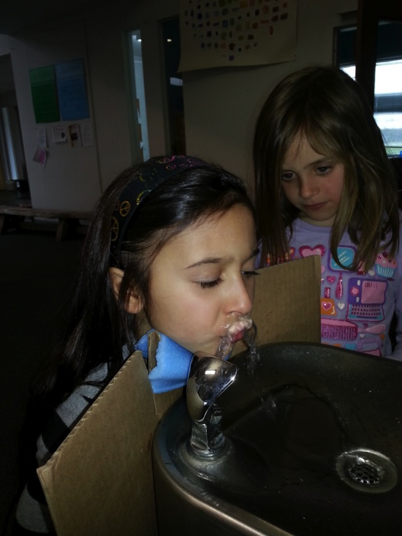
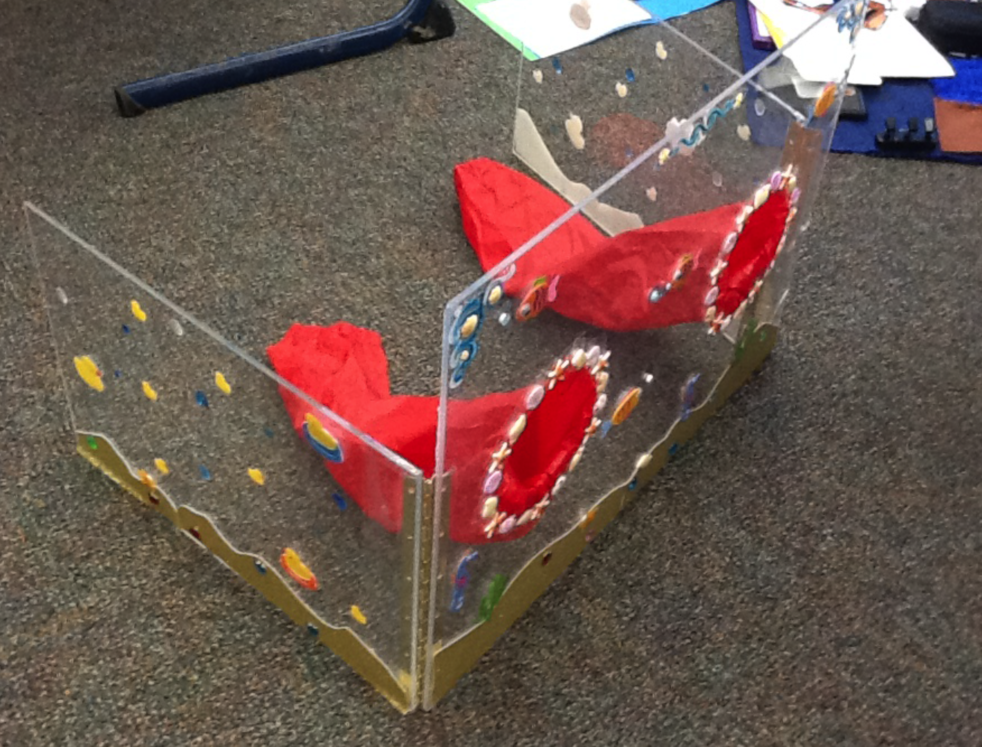
Build a Prototype
Working
Prototype
Crude
Prototype
Final
Prototype
Hand Wash Splash Guard
Alisha C.
Kansas,USA
Spelling Pencil
Morgan F.
Pennsylvania,USA
Dr. BOT Fountain Mask
Devyn E., Rachel S. Beatrix H., Olive P., Tola B.
New York, USA
Notes:
The word “prototype” means model. The model shows the shape and form of your invention. It may be actual size, or it may show the invention in miniature.
Inventors build different levels of prototypes:
A crude prototype is very simple, but it helps you get a better feel for the basic size, shape, and function of your invention.
A working prototype actually works! It allows people to try out some or all of the features of your invention.
A final prototype is a model that looks and functions like a real manufactured product.
You can select the level of prototype you wish to create. Just be sure that it demonstrates what your invention will look like and how you would like it to work!

Slide 4
To create a successful prototype…
List the materials.
Gather your materials & tools.
Build!
Notes:
To create a successful prototype….
List the materials you think you’ll need. Look back at your sketch to help you visualize what is necessary to build the model. Try to think of materials that are free (like recyclables) or very inexpensive. The prototype should be made from simple materials so that if it doesn’t work or has to be changed, you haven’t invested a lot of money.
Gather your materials and tools. It’s best not to start building until you have everything you think you’ll need in one place.
Build! As you build, photograph the process and record the steps you take in your Inventor’s Notebook. If you modify your invention as you go, make notes about the changes you make and why you made them!

Slide 5

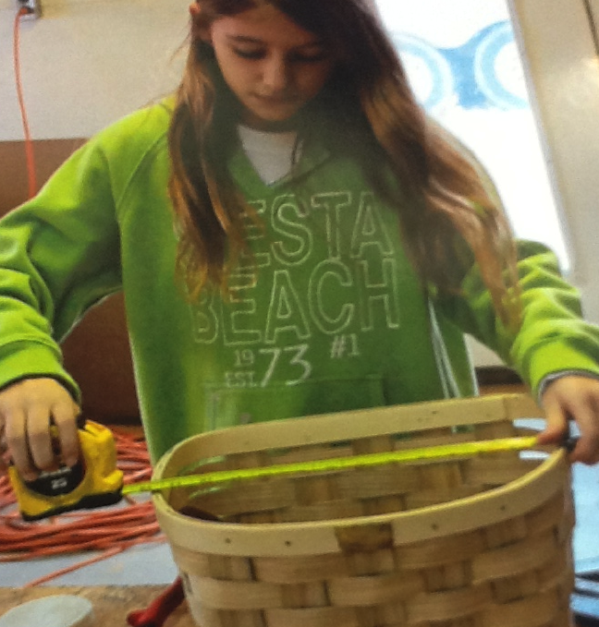
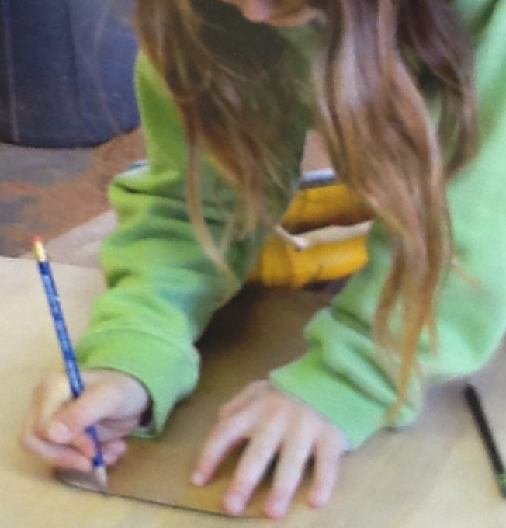
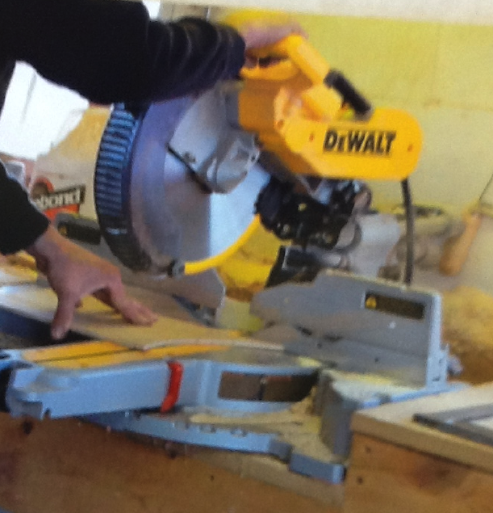
Get Started
Notes:
Get started right now by looking back at your sketch in your Inventor’s Notebook. List the materials you’ll need to build your prototype, and gather them all together. Then, start building your prototype and recording the process!
Your prototype pictures will help you you prepare your entry for submission. The judges want to see that you have built a prototype to test your idea!

Slide 6
That’s the 4th Step in the Invention Process.
Can’t wait to see your prototype
Notes:
Now you know how to complete Step 4 of the invention process, CREATE IT, by building a prototype of your invention idea.

