Slide 1
The Invention Process: Step 6
Tweak It
Improve Your Invention
Notes:
Step 6: Tweak It

Slide 2
Step 6: Tweak It
1
2
3
4
5
6
7
Notes:
In this lesson, you are going to learn how to complete the sixth step in the invention process, TWEAK IT, by using the results of your tests to improve your invention.

Slide 3
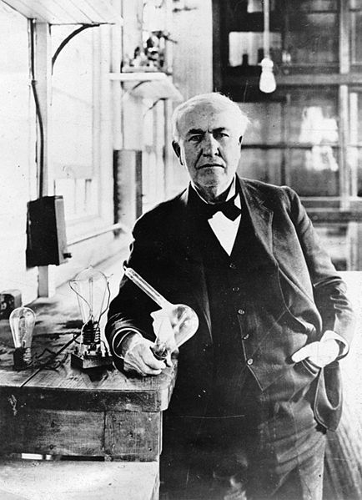
Tweak Your Invention
In his first breakthrough, he designed a lightbulb that burned for 13.5 hours!
Thomas Edison
Inventors rarely get an invention right on the first try!
Notes:
Inventors rarely get an invention right on the first try! Most inventors test and tweak their inventions many times to work out all the kinks so that their solution that can become a real product.
In fact, when Thomas Edison made his first breakthrough in 1879 in his attempt to create a long-lasting lightbulb, it lasted for only 13.5 hours.

Slide 4
Tweak Your Invention
After tweaking his invention by using different materials, his lightbulb burned over
1200 Hours!
Thomas Edison
Notes:
Less than two years later, after trying many different materials as filaments, he designed a light bulb that lasted over 1200 hours!
How do you think your invention will perform? Now it’s time to think about those test results and come up with solutions to make your invention even better.

Slide 5
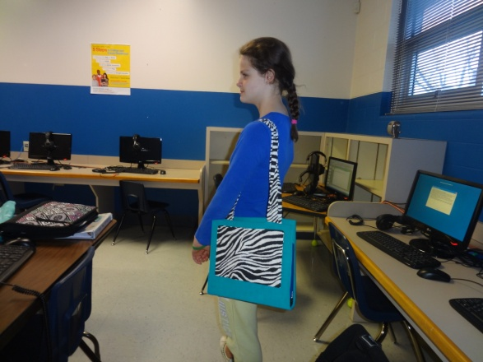
Make Improvements
Step 6: Tweak It
Anna S. Kloi B. and Mia B
Amarillo, Texas, USA
Better Binder
Notes:
In past Invent It Challenges, students like you have tweaked their prototypes in many ways.
Anna and Mia, both 10 years old, tweaked their “Better Binder” by sewing the edges to improve the overall strength of their product.

Slide 6
Make Improvements
Step 6: Tweak It
Chase L.
North Carolina, USA
Refugee Travois
Notes:
13-year-old Chase knew from his testing that his travois wasn’t strong enough to carry children, so he reinforced it with steel.

Slide 7
Review Step 5 Try It Results
List Weaknesses
Brainstorm Fixes
List Additional Materials
Adjust Your Prototype
Ask friends what they think
Notes:
To tweak your invention, start by reviewing your test results.
List each weaknesses you discovered.
Next to each weakness, brainstorm “fixes” that could address that weakness and improve your invention.
Identify and locate materials you may need.
Adjust your prototype to make it more useful, durable, or better functioning.
Ask friends or others you polled to try your prototype and share their thoughts.

Slide 8
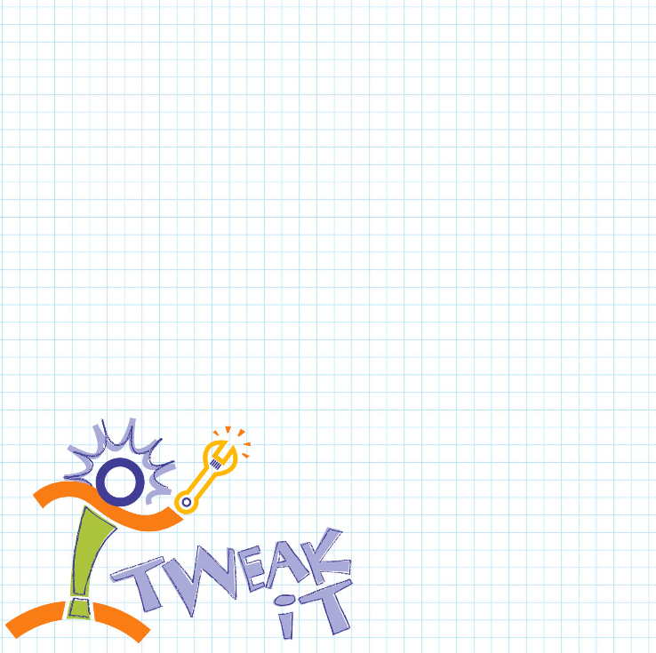
Document Your Tweaks
Do your tweaks
Record results
Document your work for judges to review
Notes:
Get started right now by determining what types of tweaking you need to do on your prototype based on your test results. Once you’ve decided on the right tweaks, make them happen! Then, conduct your tests again and document the results with notes in your Inventor’s Notebook, photos, and/or videos so you have a record of the improvements you made as you tweaked your invention. Report these changes in your entry so that judges can see your work.

Slide 9
That’s the 6th Step in the Invention Process.
Can’t wait to see your improvements!
Notes:
Now you know how to complete step six of the invention process, TWEAK IT, by adjusting your prototype and improving your invention!

