Slide 1
THE CHALLENGE
Create a new invention that helps provide access to healthy food for everyone, everywhere, every day.
HOW TO ENTER
Learn about and follow the Invention It Challenge process to create your invention. To enter, you'll submit a video or PPT of your invention journey to become eligible to win amazing prizes!
How to Use this Submission Template
As you complete each of the 7 steps of the Invention Process, document your work by taking notes, making drawings, taking pictures, and making video and audio recordings.
When you have all of your documentation gathered, insert or embed your notes, drawings, pictures, audio, and video recordings into the appropriate slide.
Do not use hyperlinks to videos posted online. Instead, insert or embed the video directly into this template from your computer.
Do not use your last name in any text area, picture, drawing, audio, or video.
Do not include information in the NOTES sections as it will not be reviewed by judges.
Review each slide of this template to make sure you have included all of your documentation.
Invite your peers, family, and teacher to review your entry and recommend improvements. Make any necessary changes before submitting your final entry.
Please delete this slide before you finalize and submit your invention presentation!

Slide 2
Things to think about as you complete your submission
Use the Scoring Guide on slides 3 and 4 to evaluate your entry and decide where it can be improved.
Document! Document! Document! As you go through each of the 7 steps of the Invention Process, make sure you have resources available to help you document your progress:
Use the Student Guide or a notebook to take notes.
Use a camera, tablet, or phone to take pictures, or record audio and video.
Review this Power Point Tutorial to understand how to insert/embed videos into this template.
Use the timeline below to help you plan when you will accomplish your goals.
Please delete this slide before you finalize and submit your invention presentation!

Slide 3
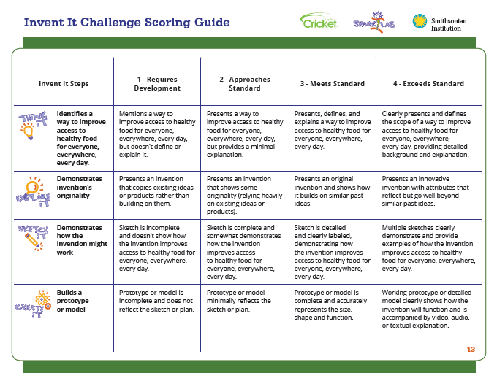
Please delete this slide before you finalize and submit your invention presentation!

Slide 4
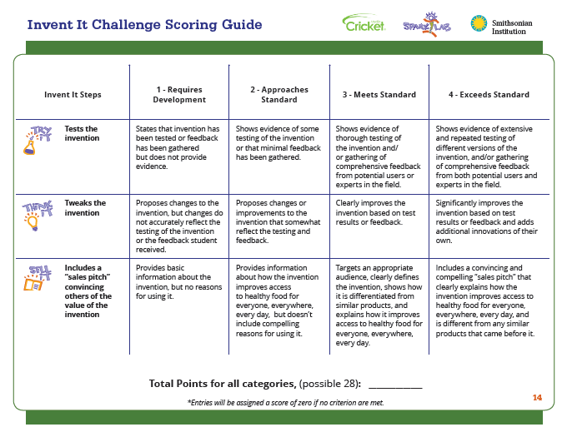
Please delete this slide before you finalize and submit your invention presentation!

Slide 5
Title of Your Invention
First Name, Last Initial
Age
State or Country

Slide 6
Describe a specific way you can help increase access to healthy food for everyone, everywhere, every day. Give detailed information about the need and how your invention meets the need.

Slide 7
Describe what other inventors have done to try and meet the need. How does your invention build on other inventions? What have you done that is new?

Slide 8
Draw pictures and diagrams to show your invention and how it might work. Label the parts in your drawing.

Slide 9
Build your prototype or model of your invention to bring your idea to life. Share pictures or video of the process and the resulting prototype.

Slide 10
Test your invention. Document how well it works. Share the ideas others provided about how it could be improved.

Slide 11
Improve your invention by modifying it based on tests you did, your ideas and feedback you received. Document exactly what you changed to improve your invention.

Slide 12
Market your invention to older adults, clearly explaining how the invention benefits them.

